Slide 1
Digital Image Processing
Introduction
Instructor Name
Dr. Muhammad Sharif

Slide 2
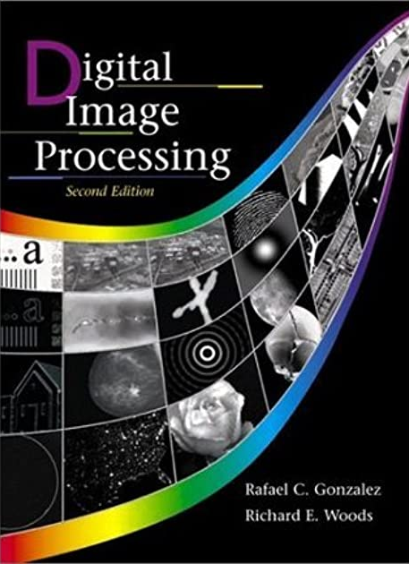
Material Reference
Images and Material
From
Rafael C. Gonzalez and Richard E. Wood,
Digital Image Processing, 2nd Edition.& Internet Resources
2

Slide 3
Introduction
“One picture is worth more than ten thousand words”
Anonymous
3

Slide 4
Contents
This lecture will cover:
What is a digital image?
What is digital image processing?
History of digital image processing
State of the art examples of digital image processing
Key stages in digital image processing
4

Slide 5

What is a Digital Image?
A digital image is a representation of a two-dimensional image as a finite set of digital values, called picture elements or pixels
5
Notes:
Real world is continuous – an image is simply a digital approximation of this.

Slide 6

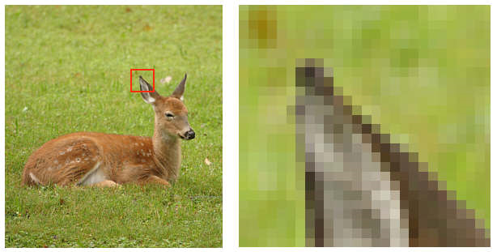
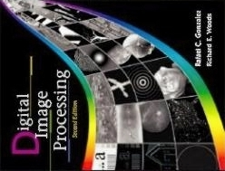
What is a Digital Image? (cont…)
Pixel values typically represent gray levels, colours, heights, opacities etc
Remember digitization implies that a digital image is an approximation of a real scene
1 pixel
6

Slide 7
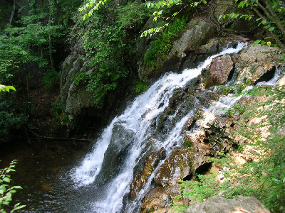
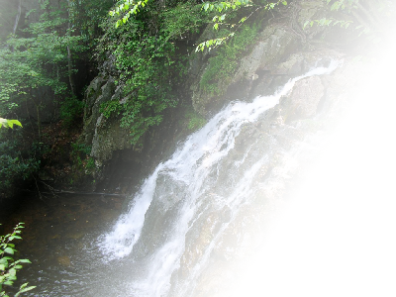
What is a Digital Image? (cont…)
Common image formats include:
1 sample per point (B&W or Grayscale)
3 samples per point (Red, Green, and Blue)
4 samples per point (Red, Green, Blue, and “Alpha”, a.k.a. Opacity)
For most of this course we will focus on grey-scale images
7

Slide 8
What is Digital Image Processing?
Digital image processing focuses on two major tasks
Improvement of pictorial information for human interpretation
Processing of image data for storage, transmission and representation for autonomous machine perception
Some argument about where image processing ends and fields such as image analysis and computer vision start
8

Slide 9
What is DIP? (cont…)
The continuum from image processing to computer vision can be broken up into low-, mid- and high-level processes
Low Level Process
Mid Level Process
High Level Process
Input: Image Output: Image
Examples: Noise removal, image sharpening
Input: Image Output: Attributes
Examples: Object recognition, segmentation
Input: Attributes Output: Understanding
Examples: Scene understanding, autonomous navigation
9
Notes:
Give the analogy of the character recognition system.
Low Level: Cleaning up the image of some text
Mid level: Segmenting the text from the background and recognising individual characters
High level: Understanding what the text says

Slide 10
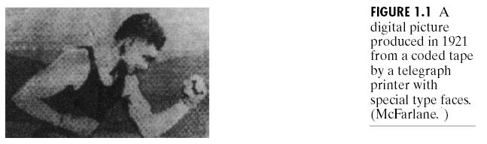
History of Digital Image Processing
Early 1920s: One of the first applications of digital imaging was in the news- paper industry
The Bartlane cable picture transmission service
Images were transferred by submarine cable between London and New York
Pictures were coded for cable transfer and reconstructed at the receiving end on a telegraph printer
Early digital image
10

Slide 11
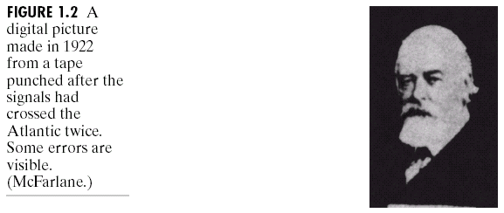
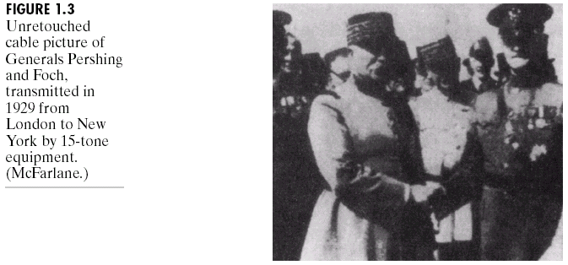
History of DIP (cont…)
Mid to late 1920s: Improvements to the Bartlane system resulted in higher quality images
New reproduction processes based on photographic techniques
Increased number of tones in reproduced images
Improved digital image
Early 15 tone digital image
11

Slide 12
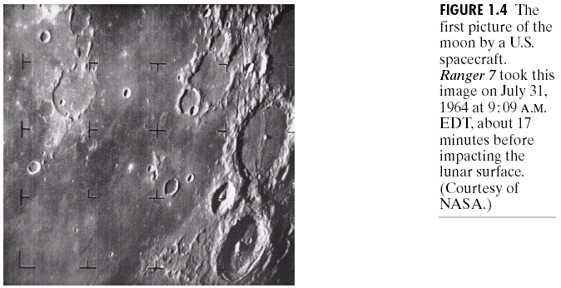
History of DIP (cont…)
1960s: Improvements in computing technology and the onset of the space race led to a surge of work in digital image processing
1964: Computers used to improve the quality of images of the moon taken by the Ranger 7 probe
Such techniques were used in other space missions including the Apollo landings
A picture of the moon taken by the Ranger 7 probe minutes before landing
12

Slide 13
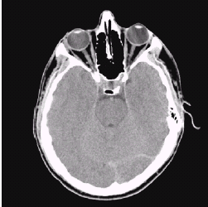
History of DIP (cont…)
1970s: Digital image processing begins to be used in medical applications
1979: Sir Godfrey N. Hounsfield & Prof. Allan M. Cormack share the Nobel Prize in medicine for the invention of tomography, the technology behind Computerised Axial Tomography (CAT) scans
Typical head slice CAT image
13

Slide 14
History of DIP (cont…)
1980s - Today: The use of digital image processing techniques has exploded, and they are now used for all kinds of tasks in all kinds of areas
Image enhancement/restoration
Artistic effects
Medical visualisation
Industrial inspection
Law enforcement
Human computer interfaces
14

Slide 15
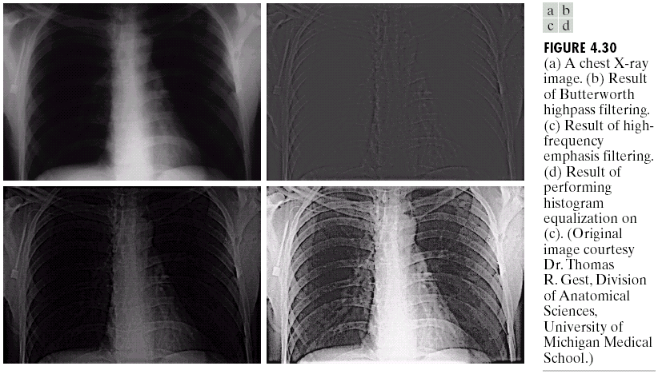
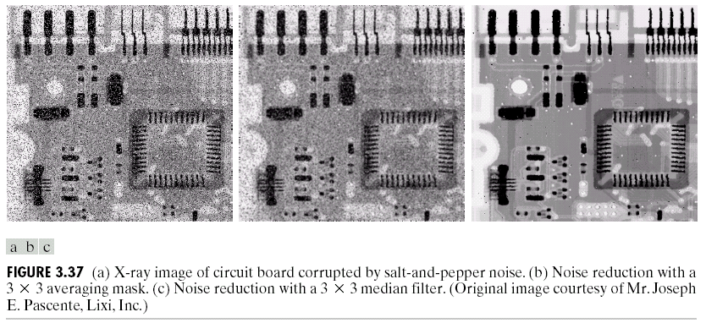
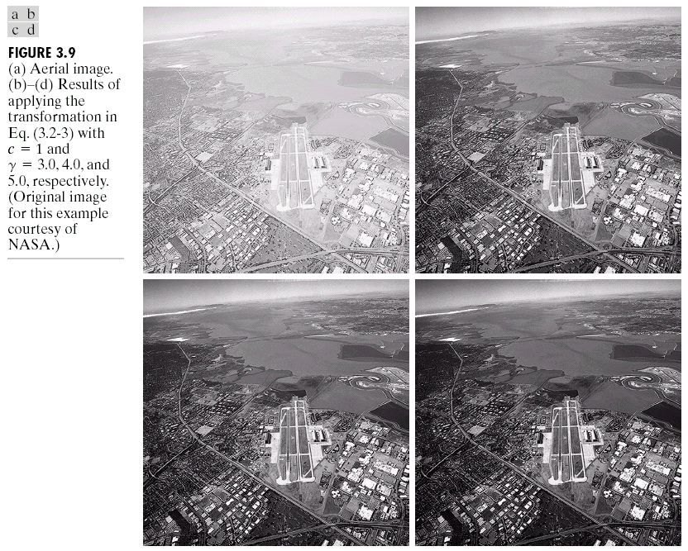
Examples: Image Enhancement
One of the most common uses of DIP techniques: improve quality, remove noise etc
15

Slide 16
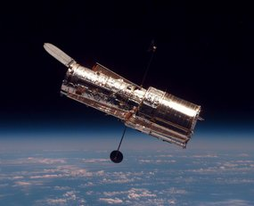
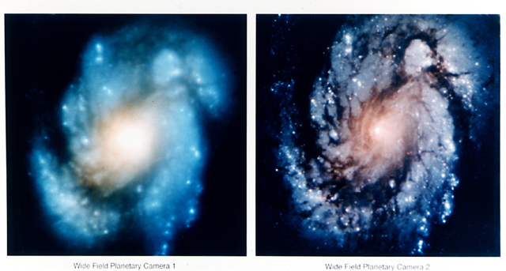
Examples: The Hubble Telescope
However, an incorrect mirror made many of Hubble’s images useless
Image processing techniques were used to fix this
Launched in 1990 the Hubble telescope can take images of very distant objects
16

Slide 17
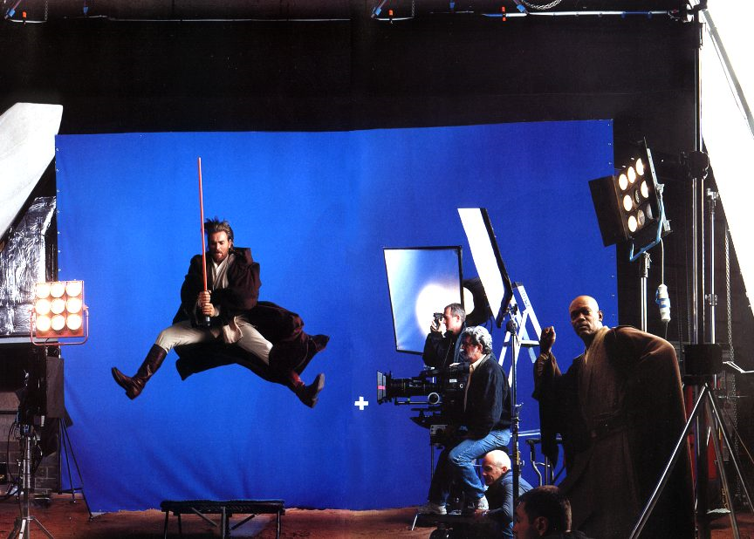
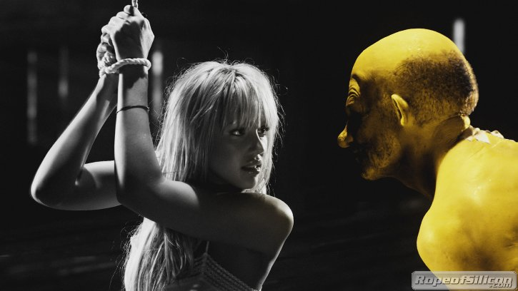
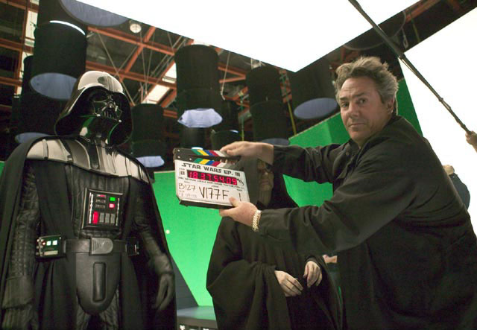
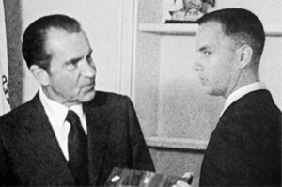
Examples: Artistic Effects
Artistic effects are used to make images more visually appealing, to add special effects and to make composite images
17

Slide 18
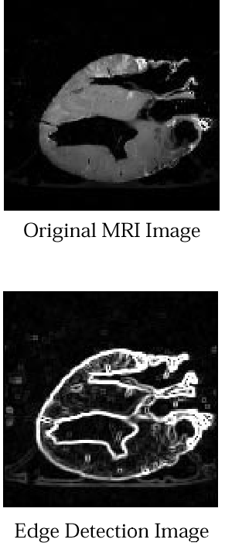
Examples: Medicine
Take slice from MRI scan of canine heart, and find boundaries between types of tissue
Image with gray levels representing tissue density
Use a suitable filter to highlight edges
Original MRI Image of a Dog Heart
18
Edge Detection Image

Slide 19
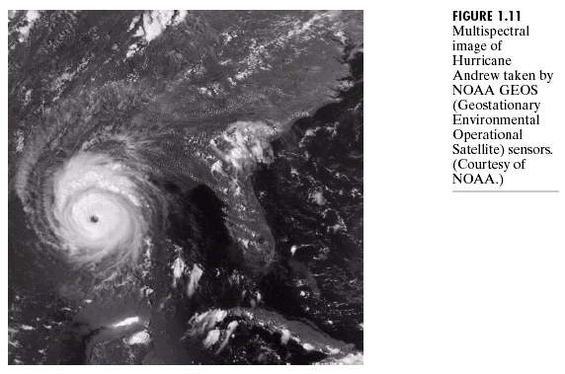
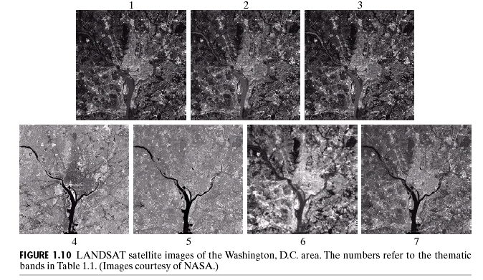
Examples: GIS
Geographic Information Systems
Digital image processing techniques are used extensively to manipulate satellite imagery
Terrain classification
Meteorology
19

Slide 20
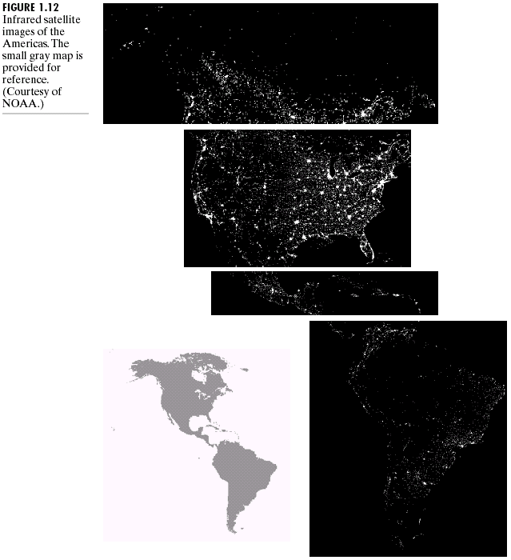
Examples: GIS (cont…)
Night-Time Lights of the World data set
Global inventory of human settlement
Not hard to imagine the kind of analysis that might be done using this data
20

Slide 21
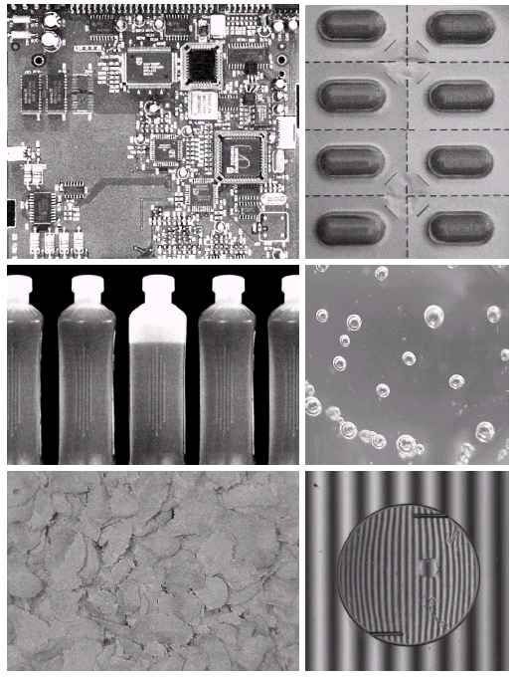
Examples: Industrial Inspection
Human operators are expensive, slow and unreliable
Make machines do the job instead
Industrial vision systems are used in all kinds of industries
Can we trust them?
21

Slide 22
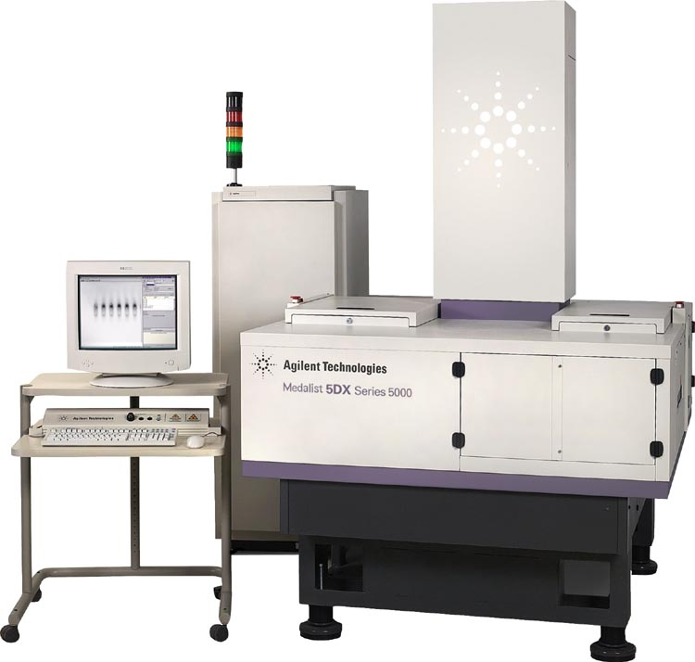
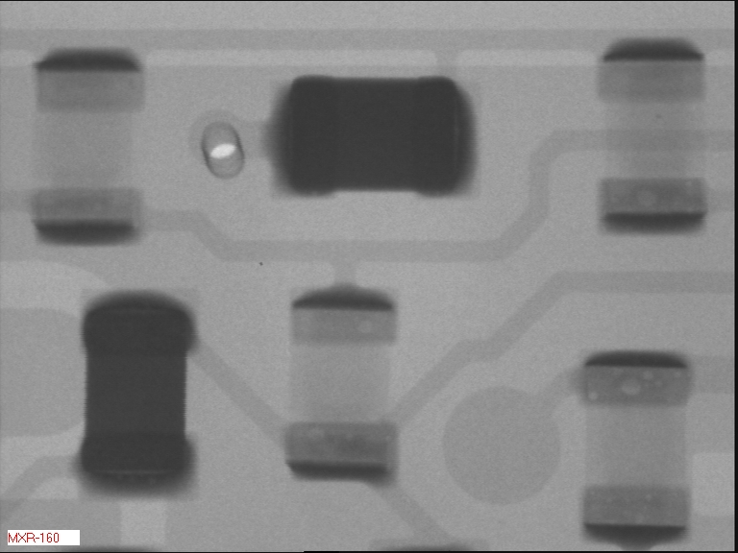
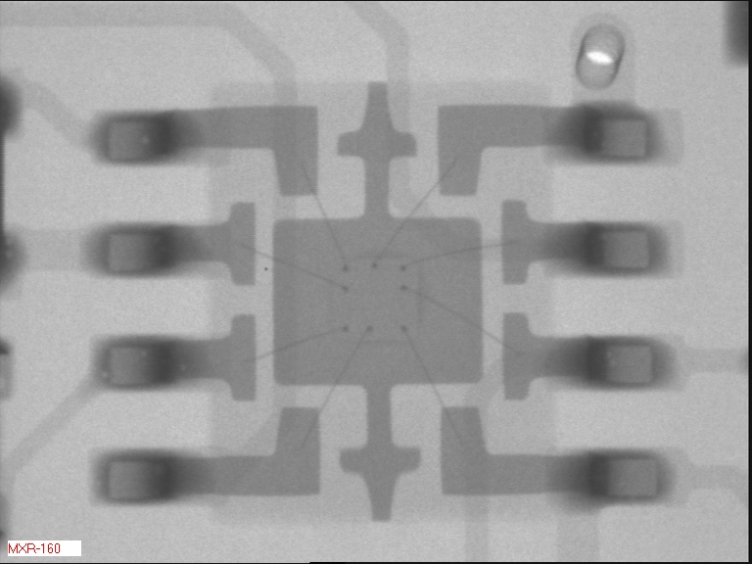
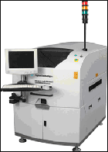
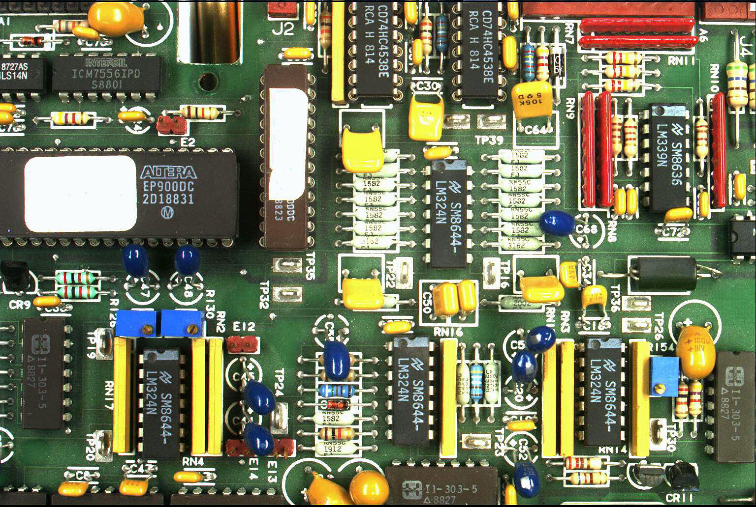
Examples: PCB Inspection
Printed Circuit Board (PCB) inspection
Machine inspection is used to determine that all components are present and that all solder joints are acceptable
Both conventional imaging and x-ray imaging are used
22

Slide 23
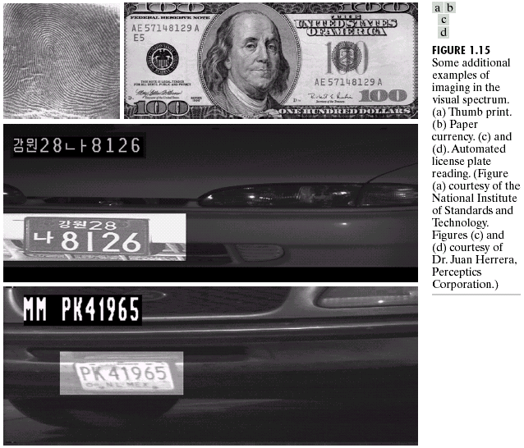
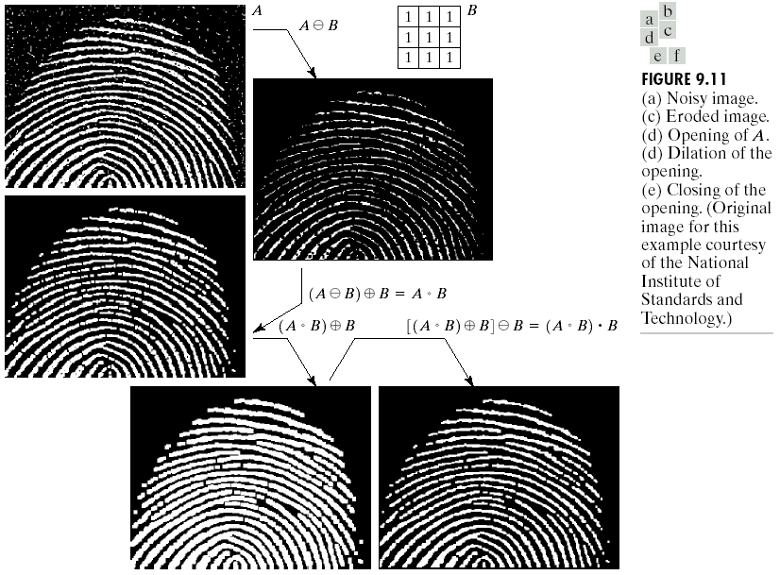
Examples: Law Enforcement
Image processing techniques are used extensively by law enforcers
Number plate recognition for speed cameras/automated toll systems
Fingerprint recognition
Enhancement of CCTV images
23

Slide 24
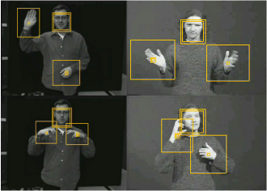
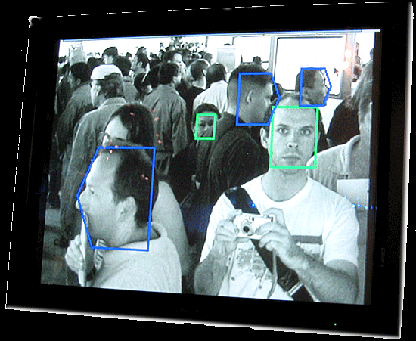
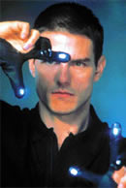
Examples: HCI
Try to make human computer interfaces more natural
Face recognition
Gesture recognition
Does anyone remember the user interface from “Minority Report”?
These tasks can be extremely difficult
24

Slide 25
Key Stages in Digital Image Processing
Image Restoration
Morphological Processing
Image Enhancement
Segmentation
Image Acquisition
Object Recognition
Colour Image Processing
Image Compression
Representation & Description
Problem Domain
25

Slide 26
Key Stages in Digital Image Processing: Image Acquisition
Image Restoration
Morphological Processing
Image Enhancement
Segmentation
Image Acquisition
Object Recognition
Representation & Description
Problem Domain
Colour Image Processing
Image Compression
26

Slide 27
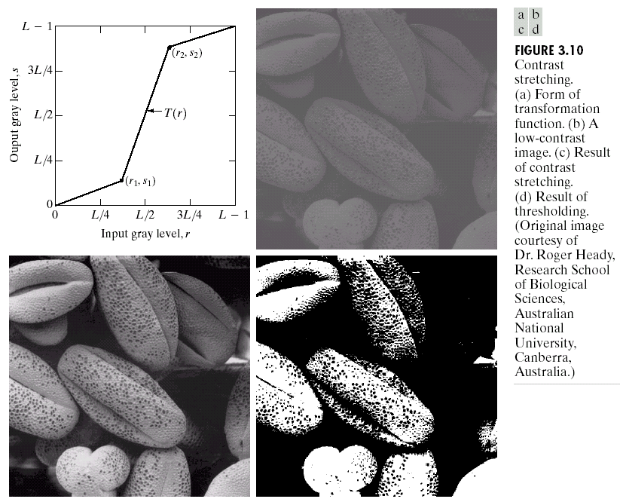
Key Stages in Digital Image Processing: Image Enhancement
Image Restoration
Morphological Processing
Image Enhancement
Segmentation
Image Acquisition
Object Recognition
Representation & Description
Problem Domain
Colour Image Processing
Image Compression
27

Slide 28
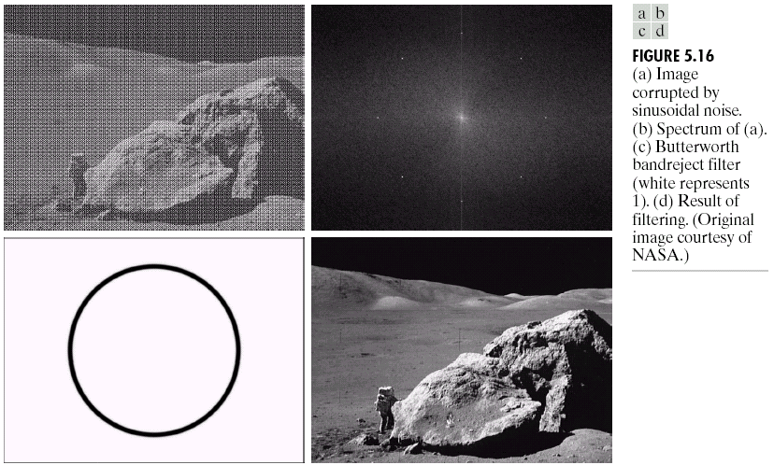
Key Stages in Digital Image Processing: Image Restoration
Image Restoration
Morphological Processing
Image Enhancement
Segmentation
Image Acquisition
Object Recognition
Representation & Description
Problem Domain
Colour Image Processing
Image Compression
28

Slide 29
Key Stages in Digital Image Processing: Morphological Processing
Image Restoration
Morphological Processing
Image Enhancement
Segmentation
Image Acquisition
Object Recognition
Representation & Description
Problem Domain
Colour Image Processing
Image Compression
29

Slide 30
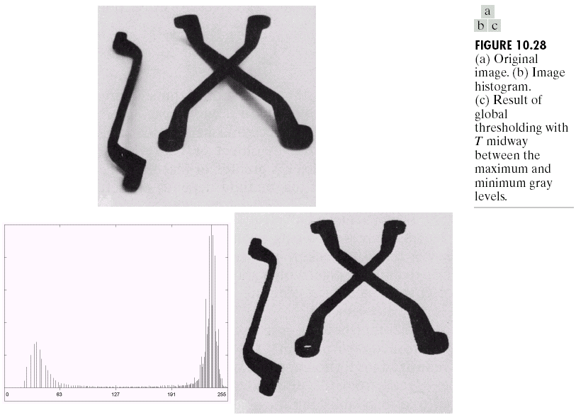
Key Stages in Digital Image Processing: Segmentation
Image Restoration
Morphological Processing
Image Enhancement
Segmentation
Image Acquisition
Object Recognition
Representation & Description
Problem Domain
Colour Image Processing
Image Compression
30

Slide 31
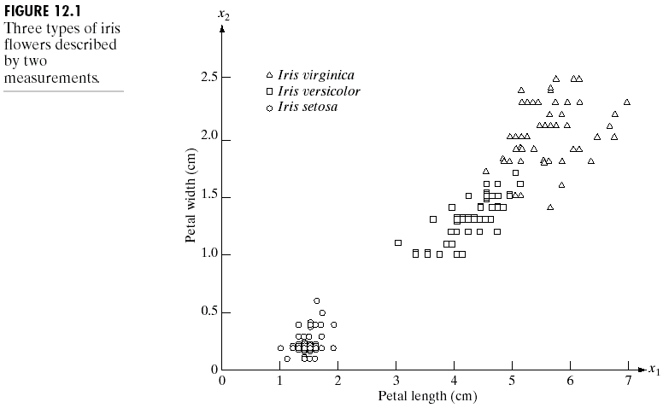
Key Stages in Digital Image Processing: Object Recognition
Image Restoration
Morphological Processing
Image Enhancement
Segmentation
Image Acquisition
Object Recognition
Representation & Description
Problem Domain
Colour Image Processing
Image Compression
31

Slide 32
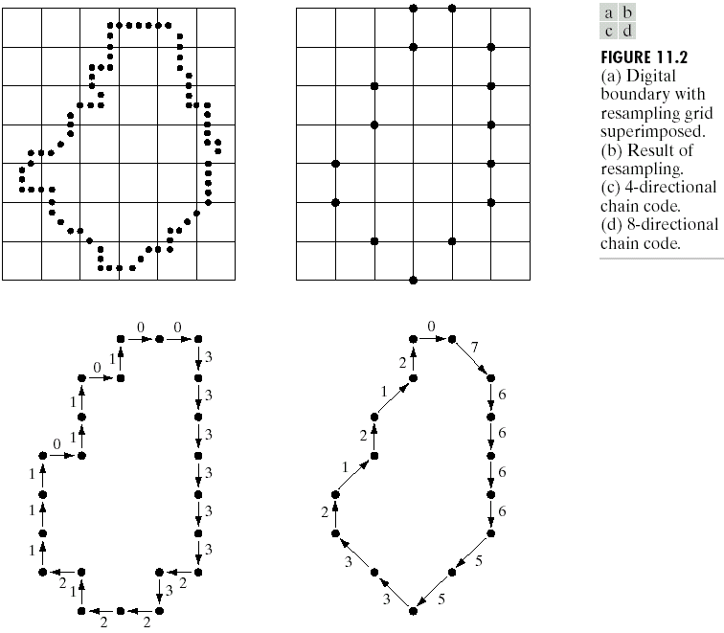
Key Stages in Digital Image Processing: Representation & Description
Image Restoration
Morphological Processing
Image Enhancement
Segmentation
Image Acquisition
Object Recognition
Representation & Description
Problem Domain
Colour Image Processing
Image Compression
32

Slide 33
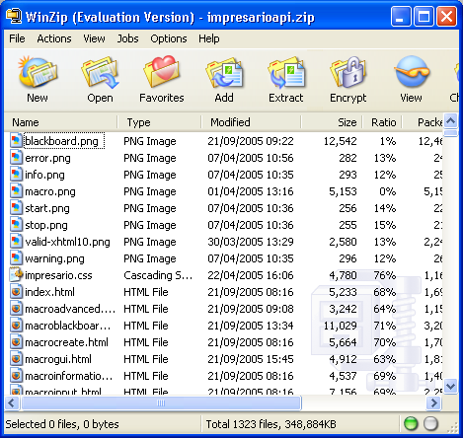
Key Stages in Digital Image Processing: Image Compression
Image Restoration
Morphological Processing
Image Enhancement
Segmentation
Image Acquisition
Object Recognition
Representation & Description
Problem Domain
Colour Image Processing
Image Compression
33

Slide 34
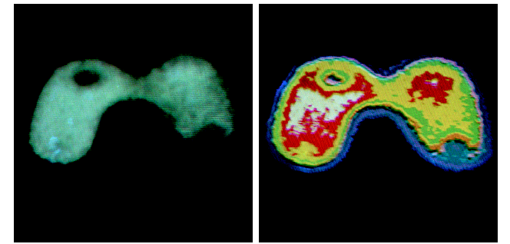
Key Stages in Digital Image Processing: Colour Image Processing
Image Restoration
Morphological Processing
Image Enhancement
Segmentation
Image Acquisition
Object Recognition
Representation & Description
Problem Domain
Colour Image Processing
Image Compression
34

Slide 35
Summary
We have looked at:
What is a digital image?
What is digital image processing?
History of digital image processing
State of the art examples of digital image processing
Key stages in digital image processing
Next week we start to see how it all works…
35

Slide 36
Next Lecture
Human visual system
Light and the electromagnetic spectrum
Image representation
Image sensing and acquisition
Sampling, quantisation and resolution
36

Slide 37
THANK YOU

